Slide 1
Data Analytics
Arcot (Raja) Rajasekar
rajasekar@unc.edu
Unit #02

Slide 2
Unit #02
Fundamentals to Data Analytics

Slide 3
Fundamental Concept in IA: #1
Finding informative variables/attributes
Is there one or more other variables that reduce our uncertainty about the value of the target variable?
Reduce uncertainty ==> model development
Var1 Var2 Var3 Var4 Var5 Target
Person ID | Age | Gender | Income | Balance | Mortgage payment
123213 | 32 | F | 25000 | 32000 | Y
17824 | 49 | M | 12000 | -3000 | N
232897 | 60 | F | 8000 | 1000 | Y
288822 | 28 | M | 9000 | 3000 | Y
…. | …. | …. | …. | …. | ….

Slide 4
Main Questions
Not all variables are informative. So,
How can we judge whether a variable provides (or models) important information about the target variable?
How can we (automatically) obtain a selection of the more informative variables with respect to the target variable?
More importantly
How can we rank these variables by importance?

Slide 5
Concept of Purity
Can I divide the data into groups such that each group is “pure” with respect to the target
By pure we mean homogeneous with respect to the target variable.
If every member of a group has the same value for the target, then the group is totally pure.
Person ID | Age | Gender | Income | Balance | Mortgage payment
123213 | 32 | F | 25000 | 32000 | Y
17824 | 49 | M | 12000 | -3000 | N
232897 | 60 | F | 8000 | 1000 | Y
288822 | 28 | M | 9000 | 3000 | Y
…. | …. | …. | …. | …. | ….

Slide 6
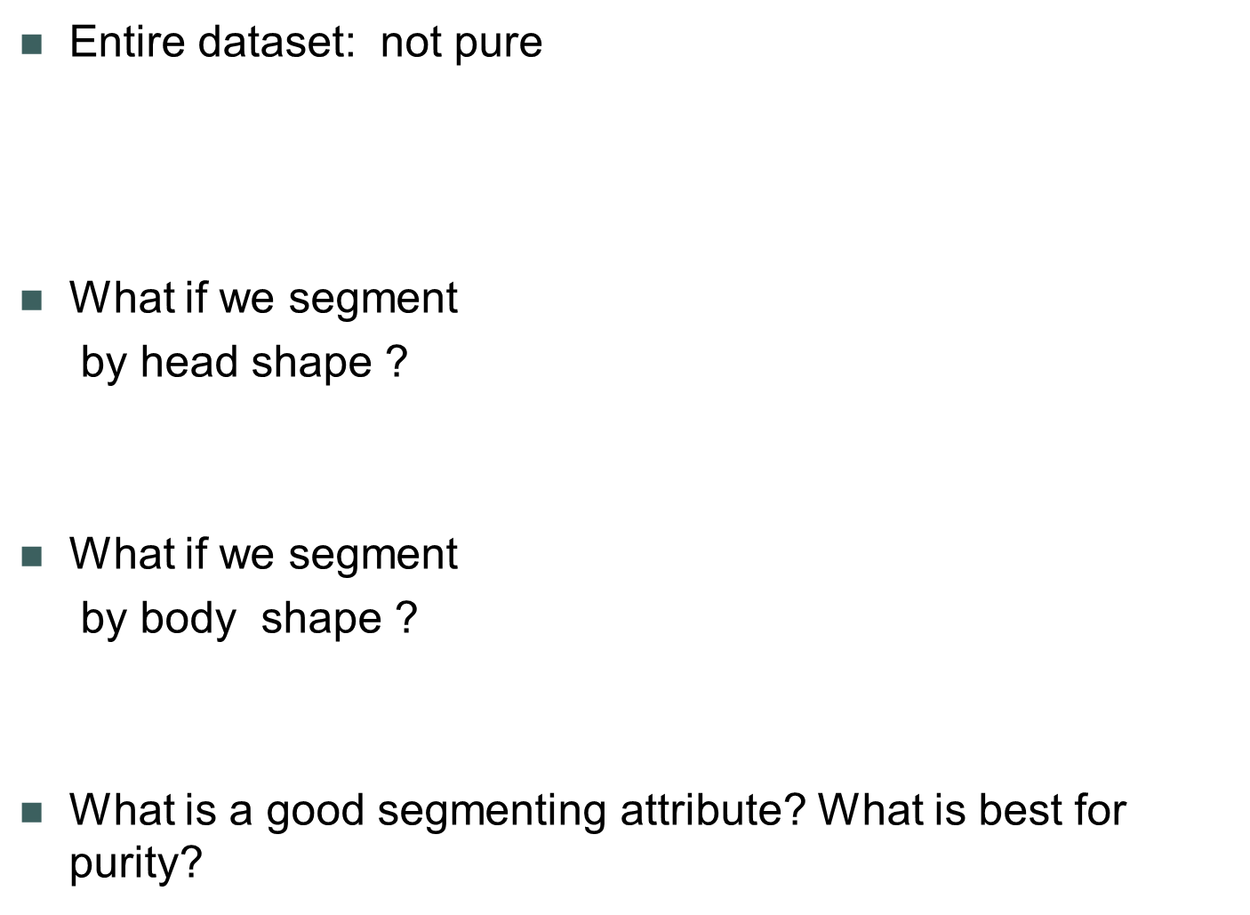
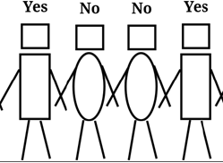

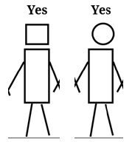
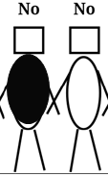

Purity: Example
<= Target Variable
<= var1: head shape
<= var2: body shape

Slide 7
Fundamental Concept in IA: #2
Segmentation
Partition (Divide) samples based on some variables:
  How best to partition my customers, with respect to differences in the target variable
How to find informative variables:
  The basis for one of the most popular, complex data mining techniques
  Segmentation
Purity plays a vital role in segmentation

Slide 8
Entropy
(a negative measure of purity)
(physics) a thermodynamic quantity representing the unavailability of a system's thermal energy for conversion into mechanical work, often interpreted as the degree of disorder or randomness in the system.
lack of order or predictability; gradual decline into disorder.
Higher the entropy more disorderly and more unpredictable is the system
Purity and Entropy are opposites…

Slide 9
Entropy
From an Information Theory viewpoint
Entropy defines the amount of information in a sequence of bits (message)
Entropy is a measure of unpredictability of information content.
Done as part of communication theory by Claude Shannon in the 40s.
Shannon is the father of Information Theory
Entropy measures diversity
Why “Entropy”? The story goes that Shannon didn't know what to call his new information measure, so he asked von Neumann, who said `You should call it entropy ... [since] ... no one knows what entropy really is, so in a debate you will always have the advantageadvantage' (Tribus 1971)

Slide 10
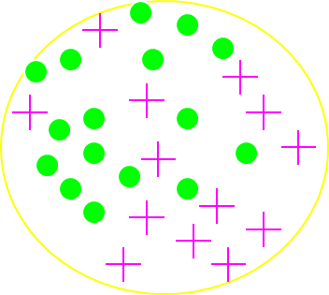



Calculating Impurity (as Entropy)
Formula for Entropy:
Entropy =
  p_{i} is the proportion of class i in the data
  For example: say our initial population is composed of target class of 14 “Circles” and 16 “Plusses”
Entropy (entire population of examples) =
Value closer to 1 = higher the entropy = lower the purity

Slide 11

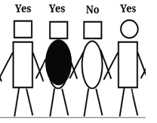
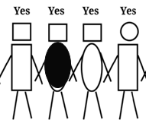

Entropy
Half Yes and Half No <= Highest Entropy, No Purity
Mostly Yes <= Low Entropy, High Purity
All are Yes <= No Entropy, Highest Purity

Slide 12
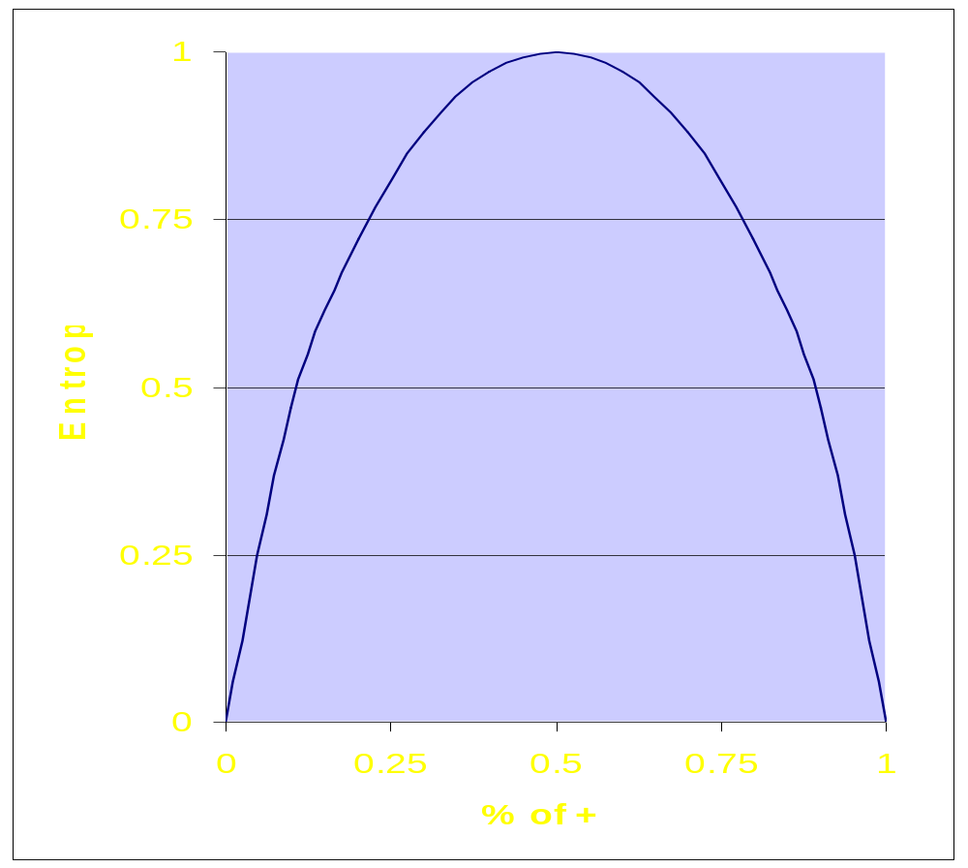
Entropy function (2 class case)
The late
Claude Shannon
of Bell Labs
was the father of
Information Theory,
a theoretical basis
for coding,
compression,
etc.
(some theories of
linguistics,
music…)
% of one class

Slide 13
Fundamental Concept in IA: #3
Information Gain
Information Gain = Reduction in entropy of the sum of the segments compared to the entropy of the whole
  Reduction of entropy => purer segments
  A measure of relevance of an attribute
    Can be tricky
    Credit card numbers are not good
Main Idea: Choose an attribute for segmenting which gives highest information gain

Slide 14
Calculating Information Gain
IG (parent, children) =
entropy(parent) − [p(c1)×entropy(c1) + p(c2)×entropy(c2) + …]
Higher IG indicates a more informative split by the variable.
Parent
Child 1
(c1)
Child 2
(c2)
Child…

Slide 15
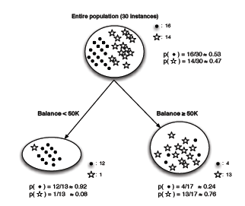
Information Gain: Compute H
Entropy(parent)
= −[p(•)×log2 p(•) +p( )×log2 p( )]
= −[0.53 ×(−0.9) +0.47 ×(−1.1)]
= 0.99 (very impure!)
Left child: entropy(Balance < 50K)
= −[p(•) log2 p(•) + p( ) log2 p( )]
= −[0.92 × (−0.12) + 0.08 × (−3.7)]
= 0.39
Right child: entropy(Balance ≥50K)
= −[p(•) log2 p(•) + p( ) log2 p( )]
= −[0.24 × (−2.1) + 0.76 × (−0.39)]
= 0.79

Slide 16
Information Gain: Compute IG
Entropy(parent)
= 0.99
Left child: entropy(Balance < 50K)
= 0.39
Right child: entropy(Balance ≥50K)
= 0.79
IG for the split based on “balance” variable :
IG = entropy(parent) − [p(Balance < 50K) × entropy(Balance < 50K)
+p(Balance ≥ 50K) × entropy(Balance ≥ 50K)]
= 0.99 − [(13/30) × 0.39 + (17/30) × 0.79] = 0.37

Slide 17
Dataset: Model the target variable about which customer pays back loan on time
Based on this dataset we will build a tree-based classifier.
person id | age>50 | gender | residence | Balance>=50,000 | mortgage payment delay
123213 | N | F | own | N | delayed
17824 | Y | M | own | Y | OK
232897 | N | F | rent | N | delayed
288822 | Y | M | other | N | delayed
…. | …. | …. | …. | …. | ….

Slide 18
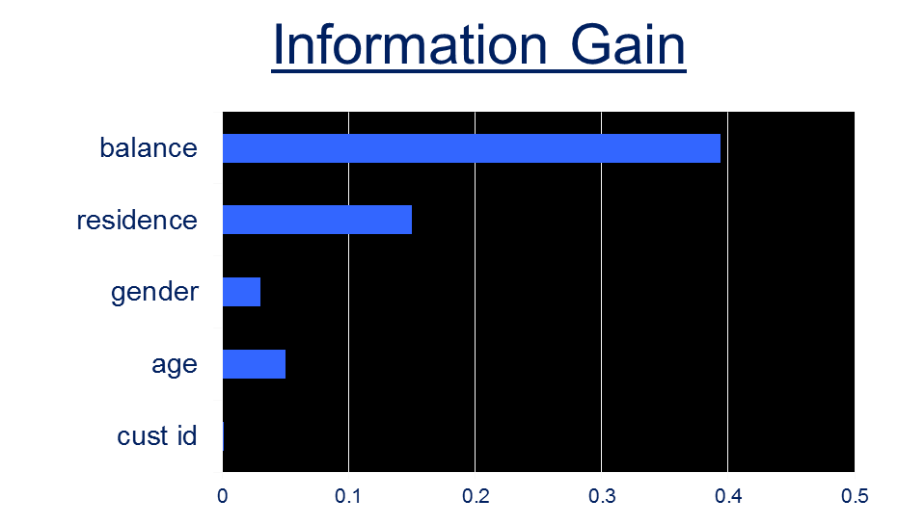
Information gain computed for each input variable
Notes:
Capital letters in names of variables on the left

Slide 19
First Segment
All customers
(14 Delay,16 OK)
Balance≥50,000
(4 delay, 12 OK)
Balance<50,000
(2 OK, 12 delay)
Balance has the best IG and hence chosen for the first segmentation
The numbers show how many samples in each segment
and their target values
Purer than the whole set but not fully pure…

Slide 20
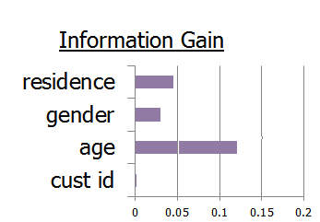
Right Limb of Tree
All customers
(14 Delay,16 OK)
Balance≥50,000
(4 delay, 12 OK)
Balance<50,000
(2 OK, 12 delay)

Slide 21
Second level of Tree
All customers
(14 Delay,16 OK)
Balance≥50,000
(4 delay, 12 OK)
Balance<50,000
(2 OK, 12 delay)
Age has the best IG and hence chosen
for second level segmentation
One sub-segment is pure
The other is not…
Age ≥ 50
OK
(1 delay,2 OK)
Age<50
Delay
(11 delay,0 OK)

Slide 22
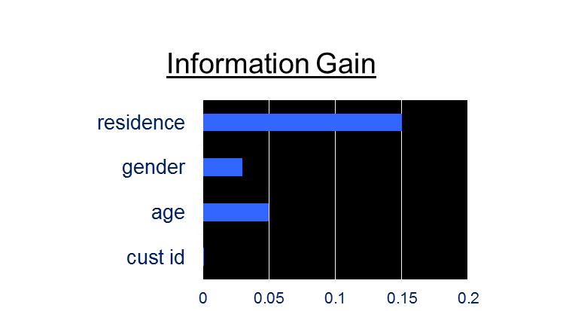
Left Limb of Tree
All customers
(14 Delay,16 OK)
Balance≥50,000
(4 delay, 12 OK)
Balance<50,000
(2 OK, 12 delay)
Age ≥ 50
OK
(1 delay,2 OK)
Age<50
Delay
(11 delay,0 OK)

Slide 23
Decision Tree
All customers
(14 Delay,16 OK)
Balance≥50,000
(4 delay, 12 OK)
Balance<50,000
(2 OK, 12 delay)
Residence = Own
OK
(0 delay, 5 OK)
Residence = Rent
OK
(1 delay, 5 OK)
Residence = Other
Delay
(3 delay, 2 OK)
Age ≥ 50
OK
(1 delay,2 OK)
Age<50
Delay
(11 delay,0 OK)
Prob(ok)=83.3%
Prob(del)=60%
Prob(ok)=40%
Prob(del)=33.3%
Prob(ok)=66.6%

Slide 24
Fundamental Concept in IA: #4
Regression
Decision Trees are great
  But may cause problems when there are a lot of input variables
  May be very hard to use with continuous values for input/target variables
Is there another way of capturing “informativeness” of an attribute?
  How much does an input variable contribute to ‘finding’ the target
Regression: a measure of the relation between the mean value of one variable called the dependent variable and corresponding values of other variables called independent variables

Slide 25
Old Example: Targeting New Life Insurance product
Data: Segmented to isolate groups
Model: Classification tree
Split over income
Income
Age
<50K
>=50K
NO
Age
45
Split over age
<45
>=45
?
NO
NO
YES
Data: Mining Phase
50K
Model: Use Phase
Income
Did not buy life insurance
New Target: Interested in LI?
Bought life insurance

Slide 26
Alternate Geometric interpretation of a model
What alternatives are there to partitioning?
+ if age > -2*Salary + 160
Age
This is called linear
discriminant analysis;
also basis of “support-vector machines”
45
50K
Salary

Slide 27

Alternate Model: Regression
Logistic Regression
p(+|x)=
Age
45
β₀ = 123
β₁ = -1.3
p(LI|x) = 0.48
50K
Income

Slide 28
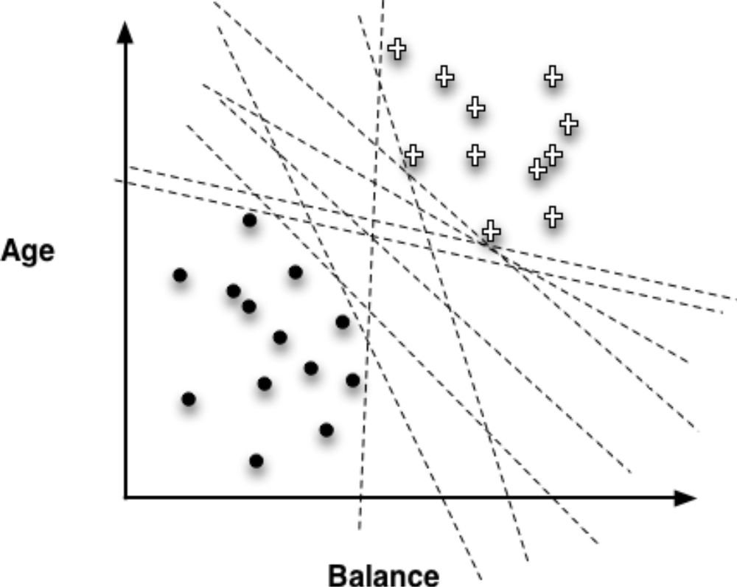
Best Discriminator

Slide 29
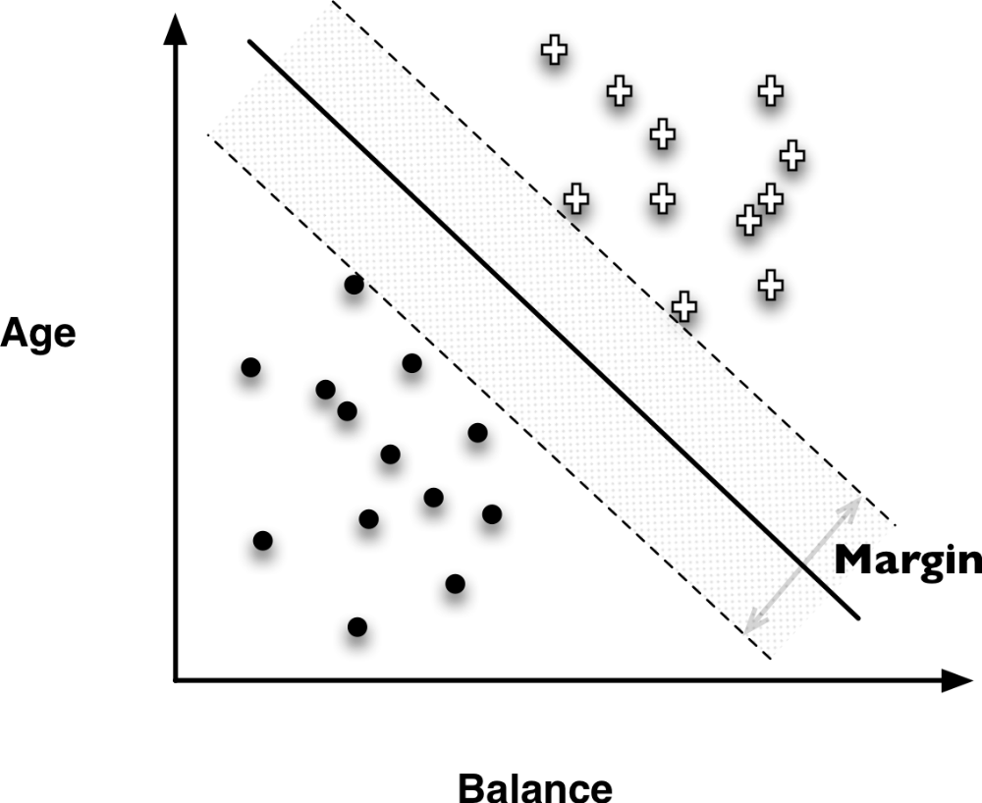
Support Vector Machines

Slide 30
SVM
C
B
Which linear discriminant should
we choose?
SVM provides a mathematical
Solution to the problem
A
Age
45
50K
Income

